Slide 1

Kobe Bryant
(1978-2020)
The Evaluation of a Champion
Ethan Goldbeck, Yuxiang Wang, Wenbin Yang, Aldo Peter
Notes:
Aldo

Slide 2

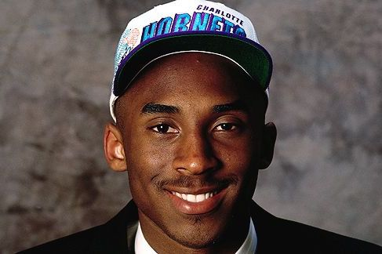
About Kobe Bryant
Kobe Bryant was born on August 23, 1978 in Philadelphia, Pennsylvania to greatly famed Joe “Jellybean” Bryant who at that time played for Philadelphia 76ers.
He entered the NBA after completing high school at Lower Merion High School.
He was 6ft 6in and weights about 205lb.
He was drafted in 1996, 13th pick overall in round 1.
Notes:
Aldo

Slide 3
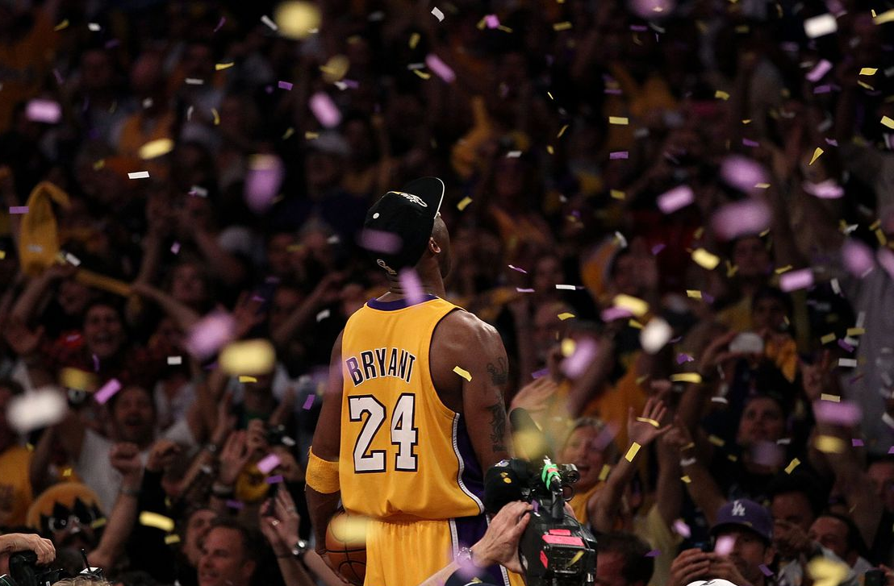
“The most important thing is to try and inspire people so that they can be great in whatever they want to do.” – Kobe Bryant
“People just don’t understand how obsessed I am with winning.” – Kobe Bryant
Notes:
Aldo

Slide 4
Career Highlights
Entered the NBA at 18 years old
18x All-Star
5x NBA Champion
2x NBA Finals MVP
MVP 2007-2008
9x NBA All Defensive First Team
2x NBA Scoring Champion
NBA Slam Dunk Contest Winner
11x all NBA first team ( tied with Karl Malone for 2nd place, only Lebron is head with 12)
Notes:
Aldo

Slide 5
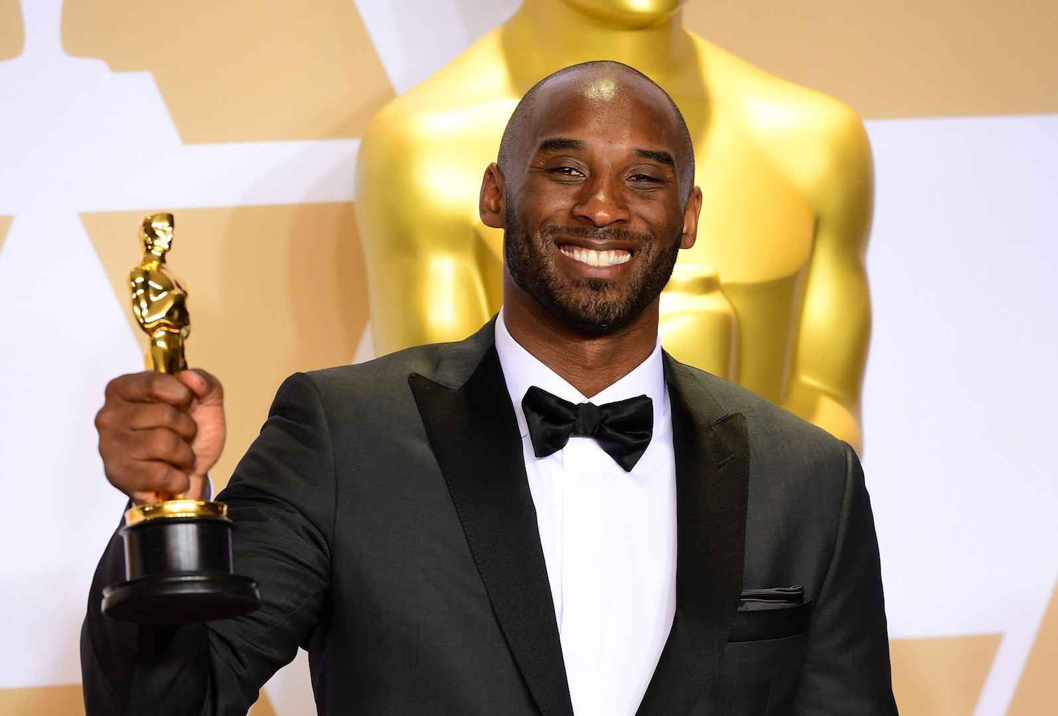
Kobe Bryant won an Oscar
Executive producer of Dear Basketball
Notes:
Aldo

Slide 6
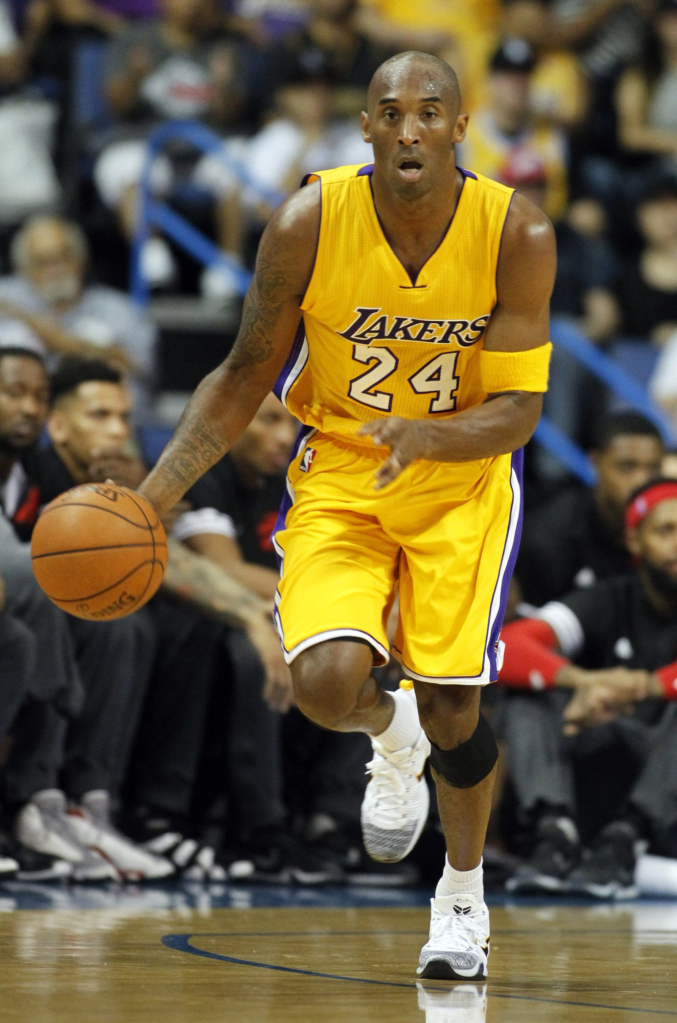
Shooting Stats
Total Shots - 26,200 (3rd all-time)
Total Made - 11,719 (7th all-time)
Total Points - 33,643 (4th all-time)
Points Per Game - 24.99 (11th all-time)
Playoffs total Made - 2,014 (5th all-time)
Playoff points - 5,640 (4th all-time)
Career High PPG - 35.40 (9th all-time)
Shots Missed - 14,481 (1st all-time)
Notes:
Aldo

Slide 7
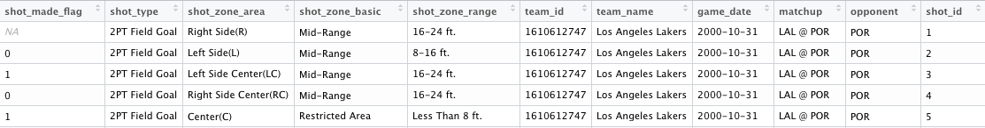
Kobe data
Columns: 25
Rows: 30697
Notes:
Aldo

Slide 8
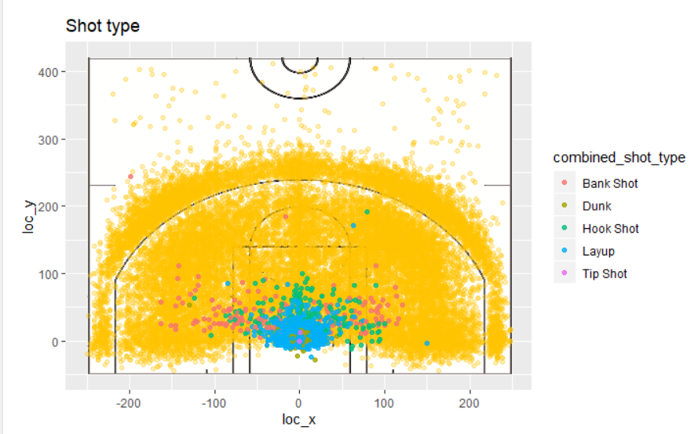
Shot Type
Notes:
Kobe took a lot of 2 point jump shots, 3 point jump shots and layups. We found are jump shots are one of the main ways kobe like to score the basketball.

Slide 9
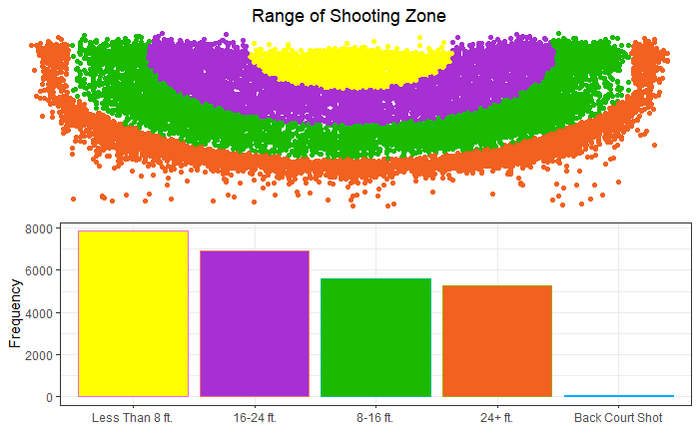
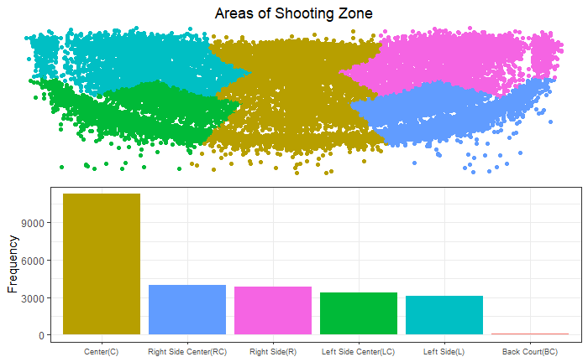
Range vs Areas
Notes:
Kobe clearly prefered to play through defenders to get to the hoop. We found that Kobe most scored in less than 8ft. Which means Kobe is always driving to the basket for lay ups, dunks and preferred jump shots plus fadeaways.

Slide 10
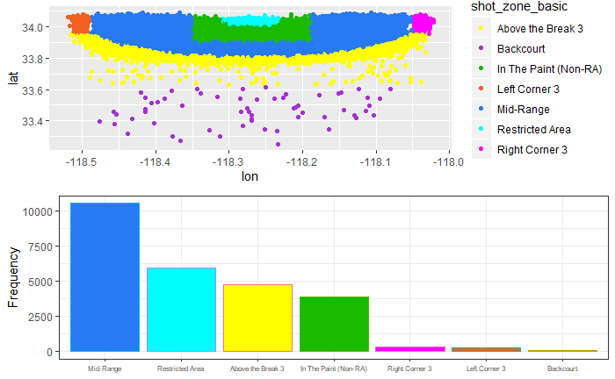
Shot Location
Notes:
Kobe most prefered shooting position is the through the center.

Slide 11
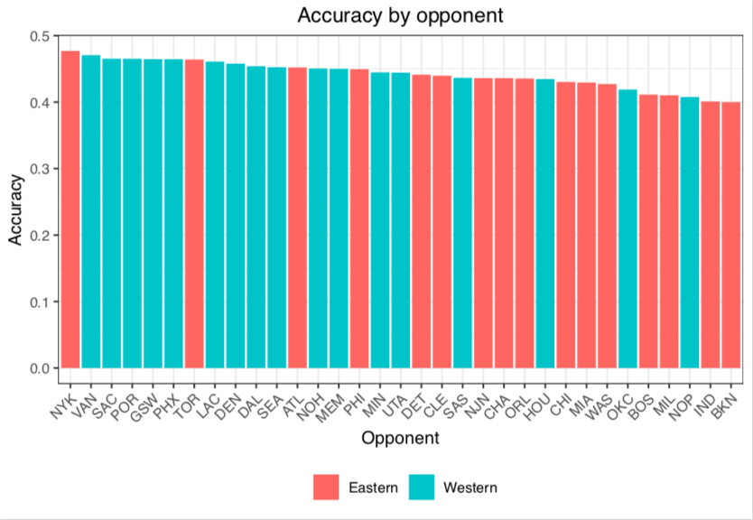
Shooting % VS Opponents
Easiest Opponents (FG%)
NYK - 47.7%
VAN - 47.06%
Toughest Opponents (FG%)
IND - 40.10%
BKN - 40.00%

Slide 12
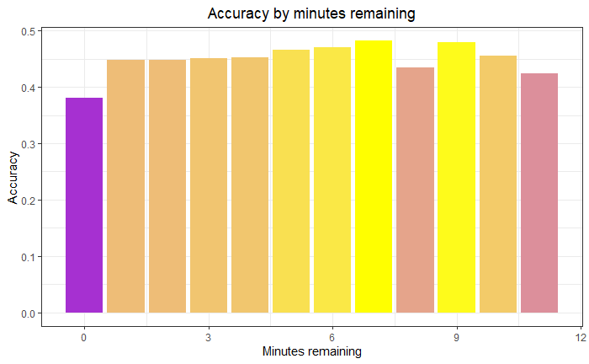
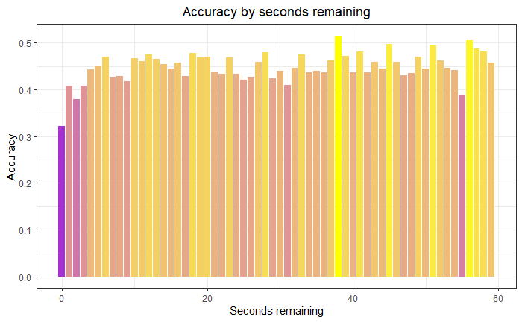
Clutch Factor

Slide 13
Clutch Factor
Based on marginal effects of glm models
Playoffs: - 0.18%
Playoffs (opponent fixed effects): 0.01%
4th Quarter: - 4.23%
Championship seasons: 0.86%
Is Kobe Clutch?
Clutch factors not in data: Score, team record, shot difficulty, opponent positioning

Slide 14
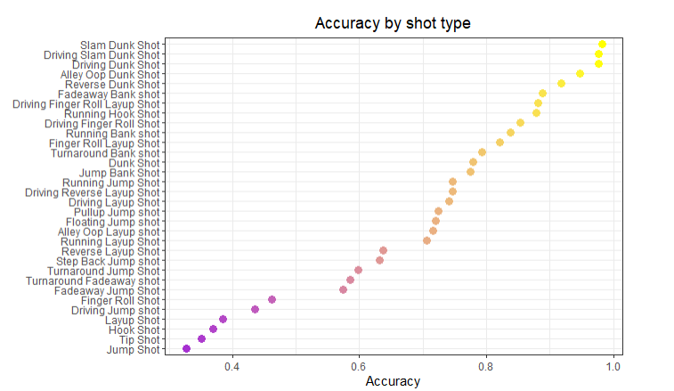
Shot Type Accuracy
Notes:
For accuracy by shot type, we found dunk has the most accuracy which makes sense. The thing that surprised us is Kobe’s fadeaway bank shot has pretty high accuracy as well, which is his most famous skill.

Slide 15
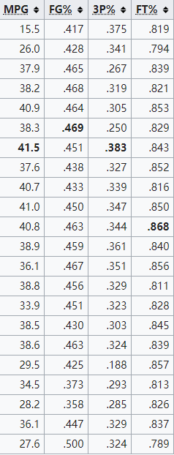
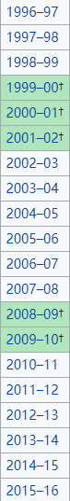
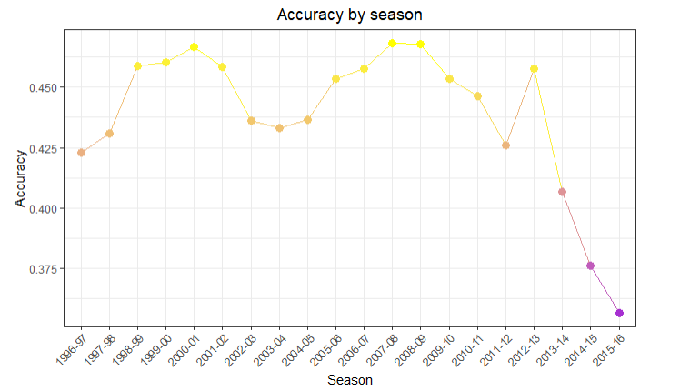
Accuracy by Season
Notes:
Kobe’s shot accuracy for most of his career has been around 45%.
Kobe’s shot accuracy has highs and lows. The lows were mostly due to injuries.

Slide 16
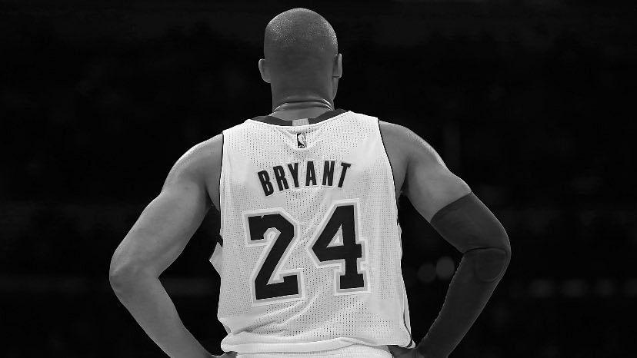
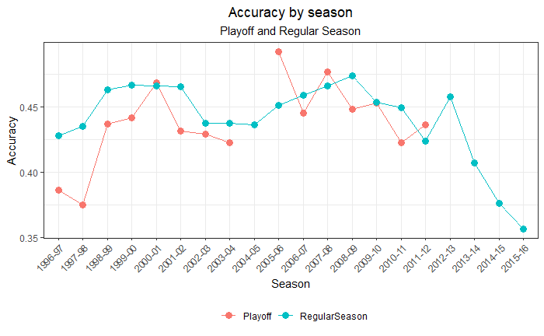
Regular Season vs Playoffs
Notes:
Kobe’s shot accuracy for most of his career has been around 45%.
Kobe’s shot accuracy has highs and lows. The lows were mostly due to injuries.

Slide 17
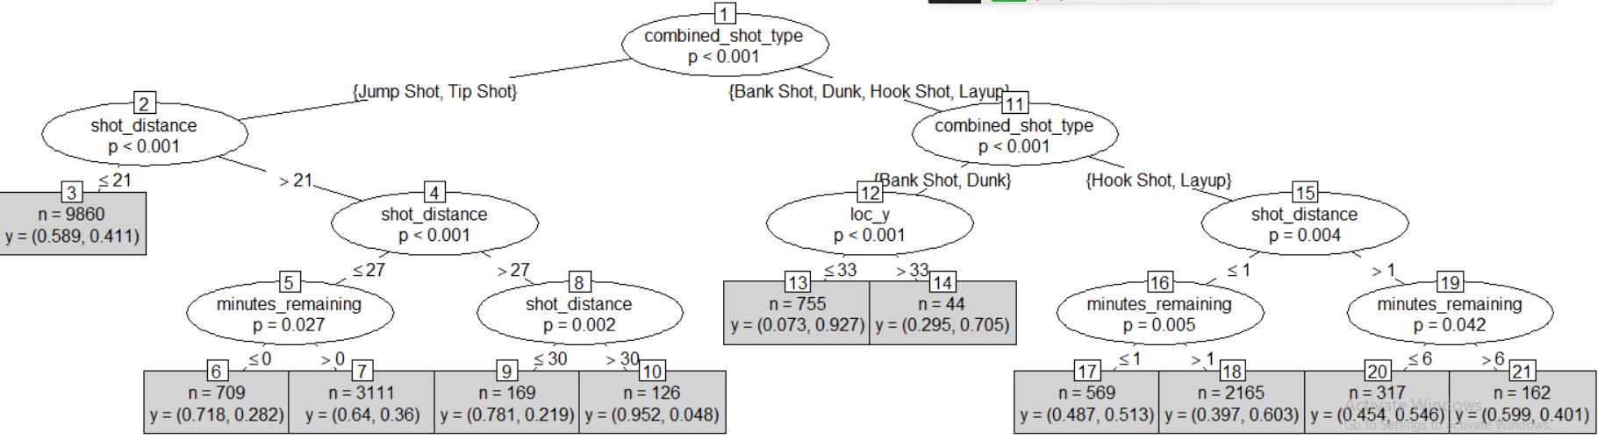
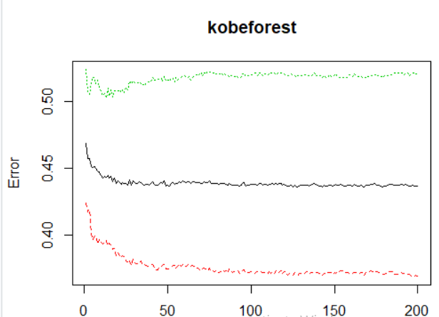
Random Forest Model
True/Predicted | 00 | 1 | Total
0 | 3435 | 822 | 4257
1 | 2213 | 1240 | 3453
Total | 5648 | 2062 | 7710
Accuracy= 0.61
Misclassification Rate = 0.39
Sensitivity = 0.35
Specificity = 0.81
Precision = 0.6

Slide 18
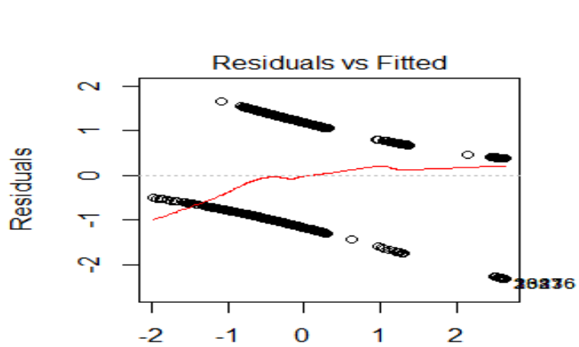
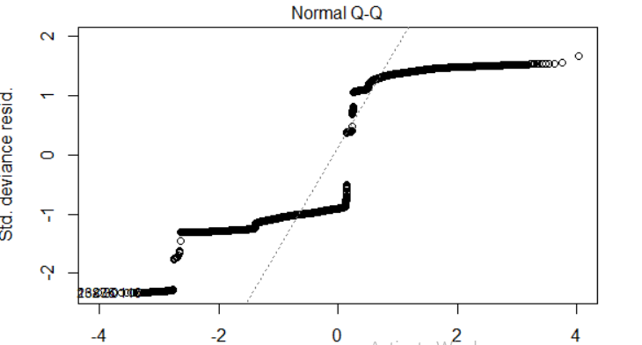
GLM model
True/Predicted | 00 | 1 | Total
0 | 3626 | 603 | 4229
1 | 2351 | 1130 | 3481
Total | 5977 | 1733 | 7710
Accuracy= 0.62
Misclassification Rate = 0.38
Sensitivity = 0.32
Specificity = 0.85
Precision = 0.65

Slide 19
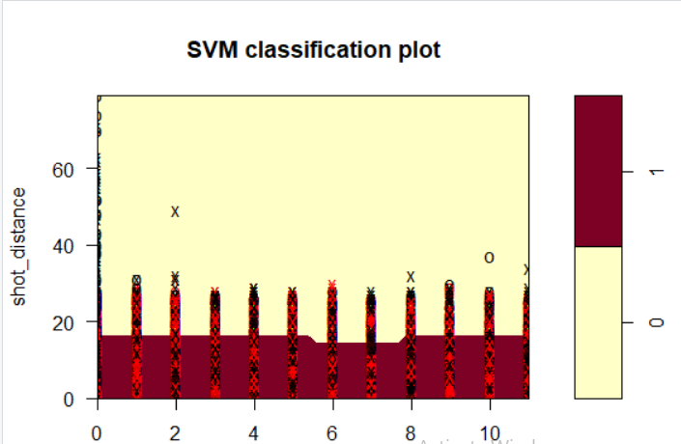
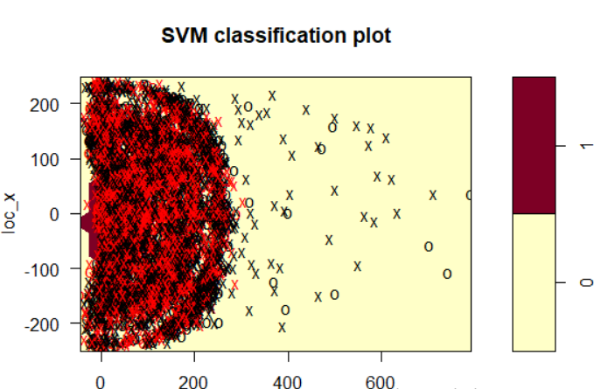
SVM model
True/Predicted | 00 | 1 | Total
0 | 3788 | 491 | 4279
1 | 2260 | 1271 | 3531
Total | 6048 | 1762 | 7710
Accuracy= 0.66
Misclassification Rate = 0.35
Sensitivity = 0.36
Specificity = 0.89
Precision = 0.72

Slide 20
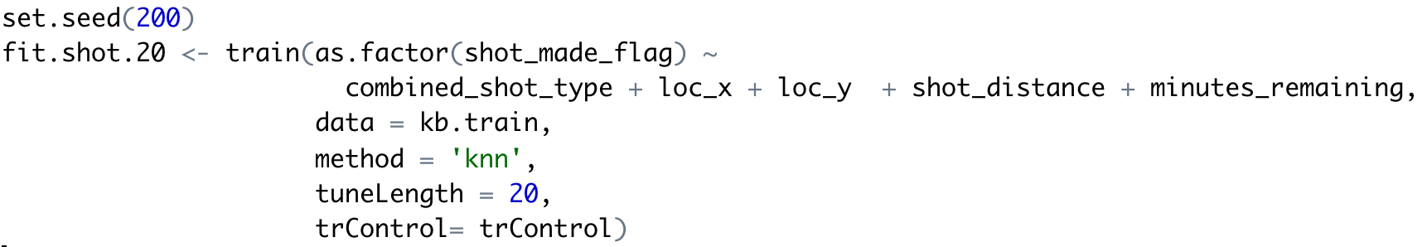
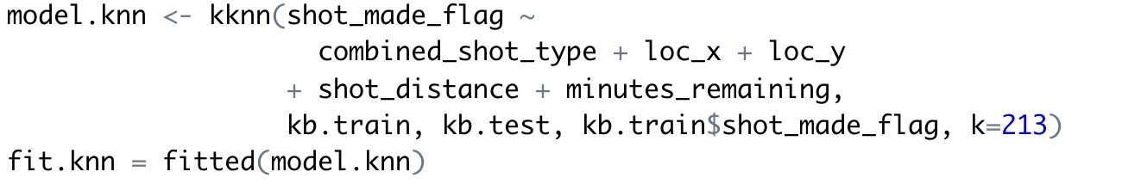
KNN model
2 different ways to build KNN model:
Using train function and making sure the method is KNN.
2. Using KKNN function.

Slide 21
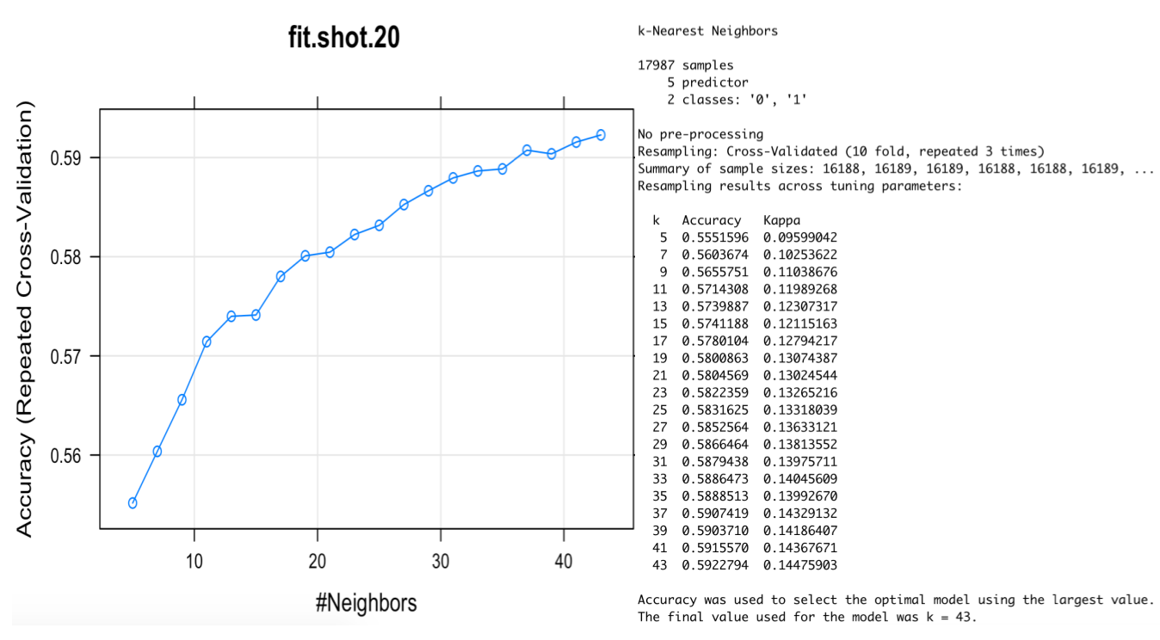
Knn model - train function(length 20)

Slide 22
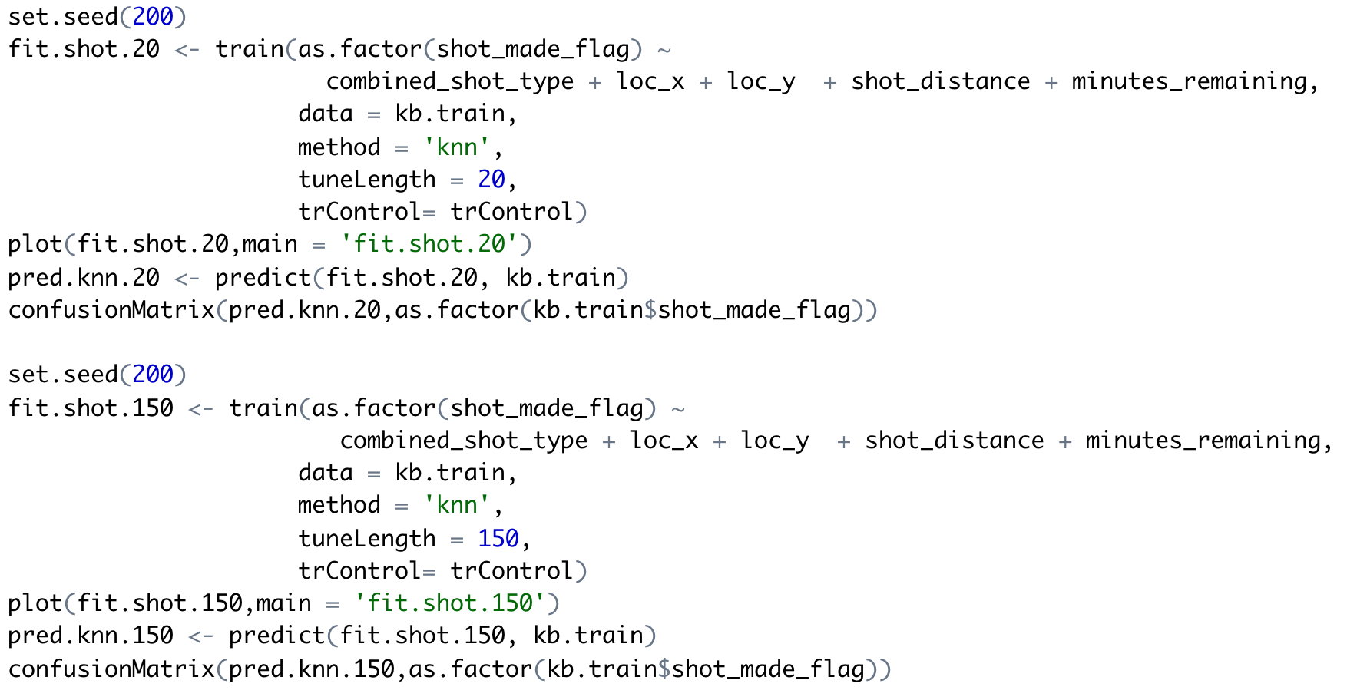
Knn model - train function(length 150)

Slide 23
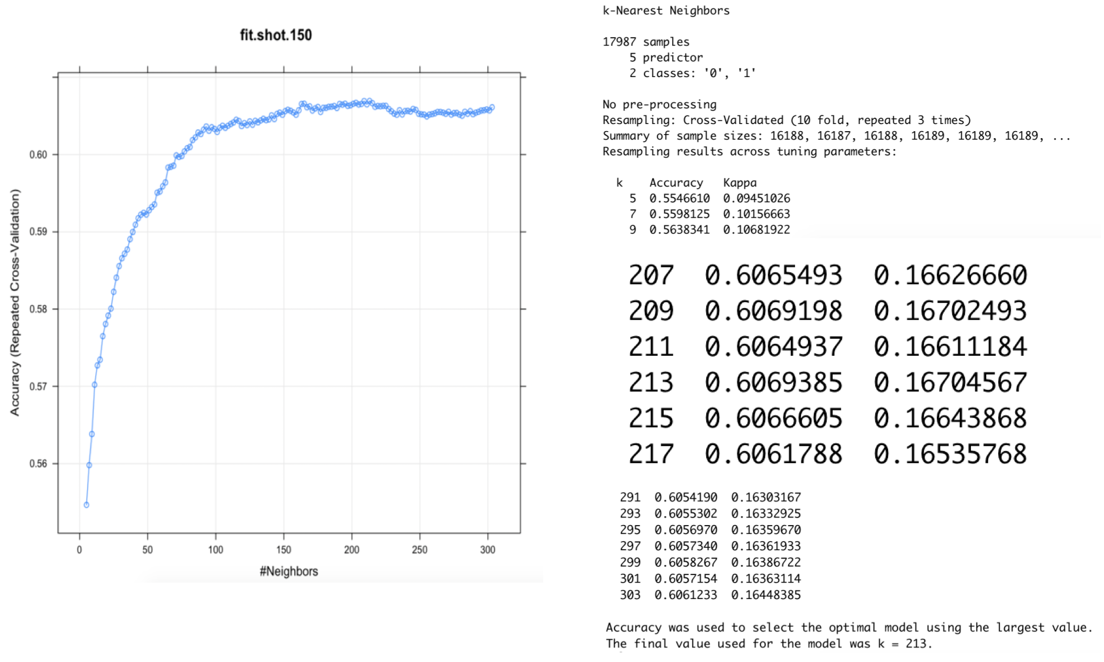
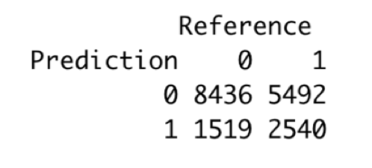
Knn model - train function(length 150)

Slide 24
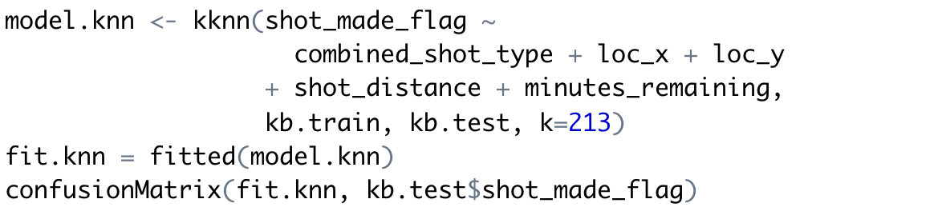
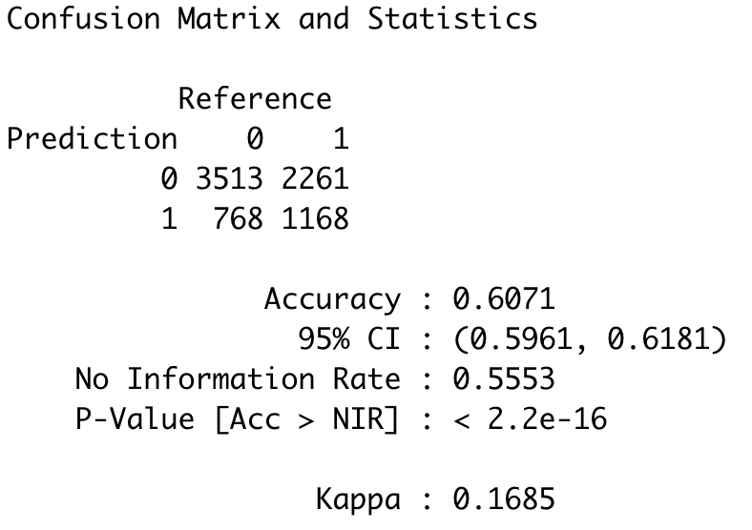
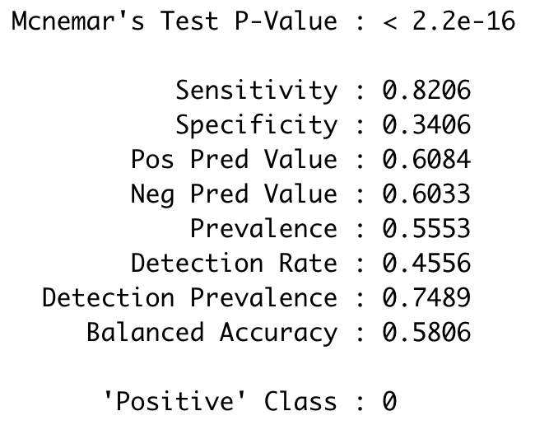
Knn model - KKNN function

Slide 25
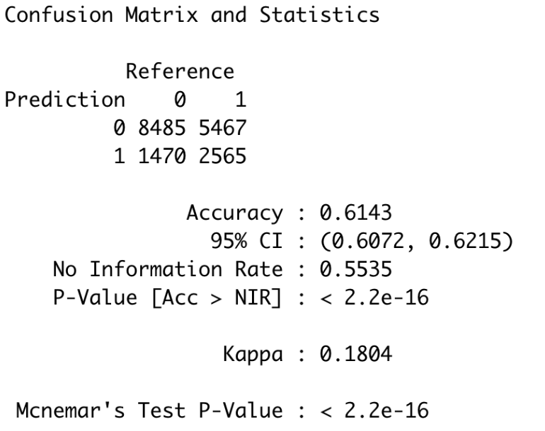
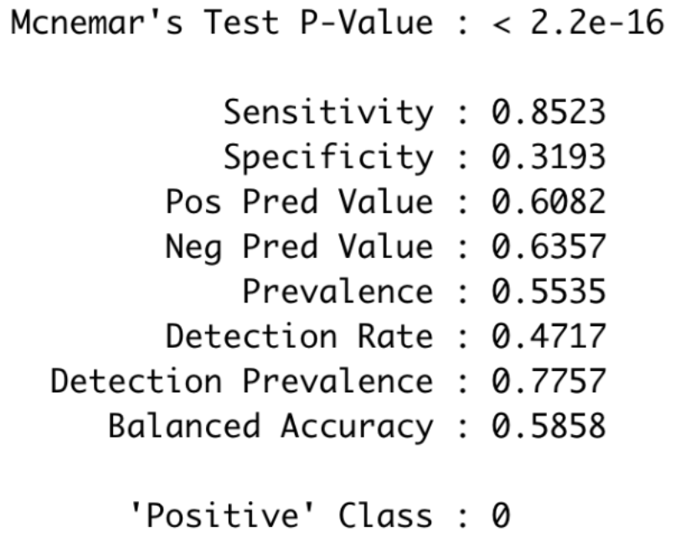
NN model - output

Slide 26
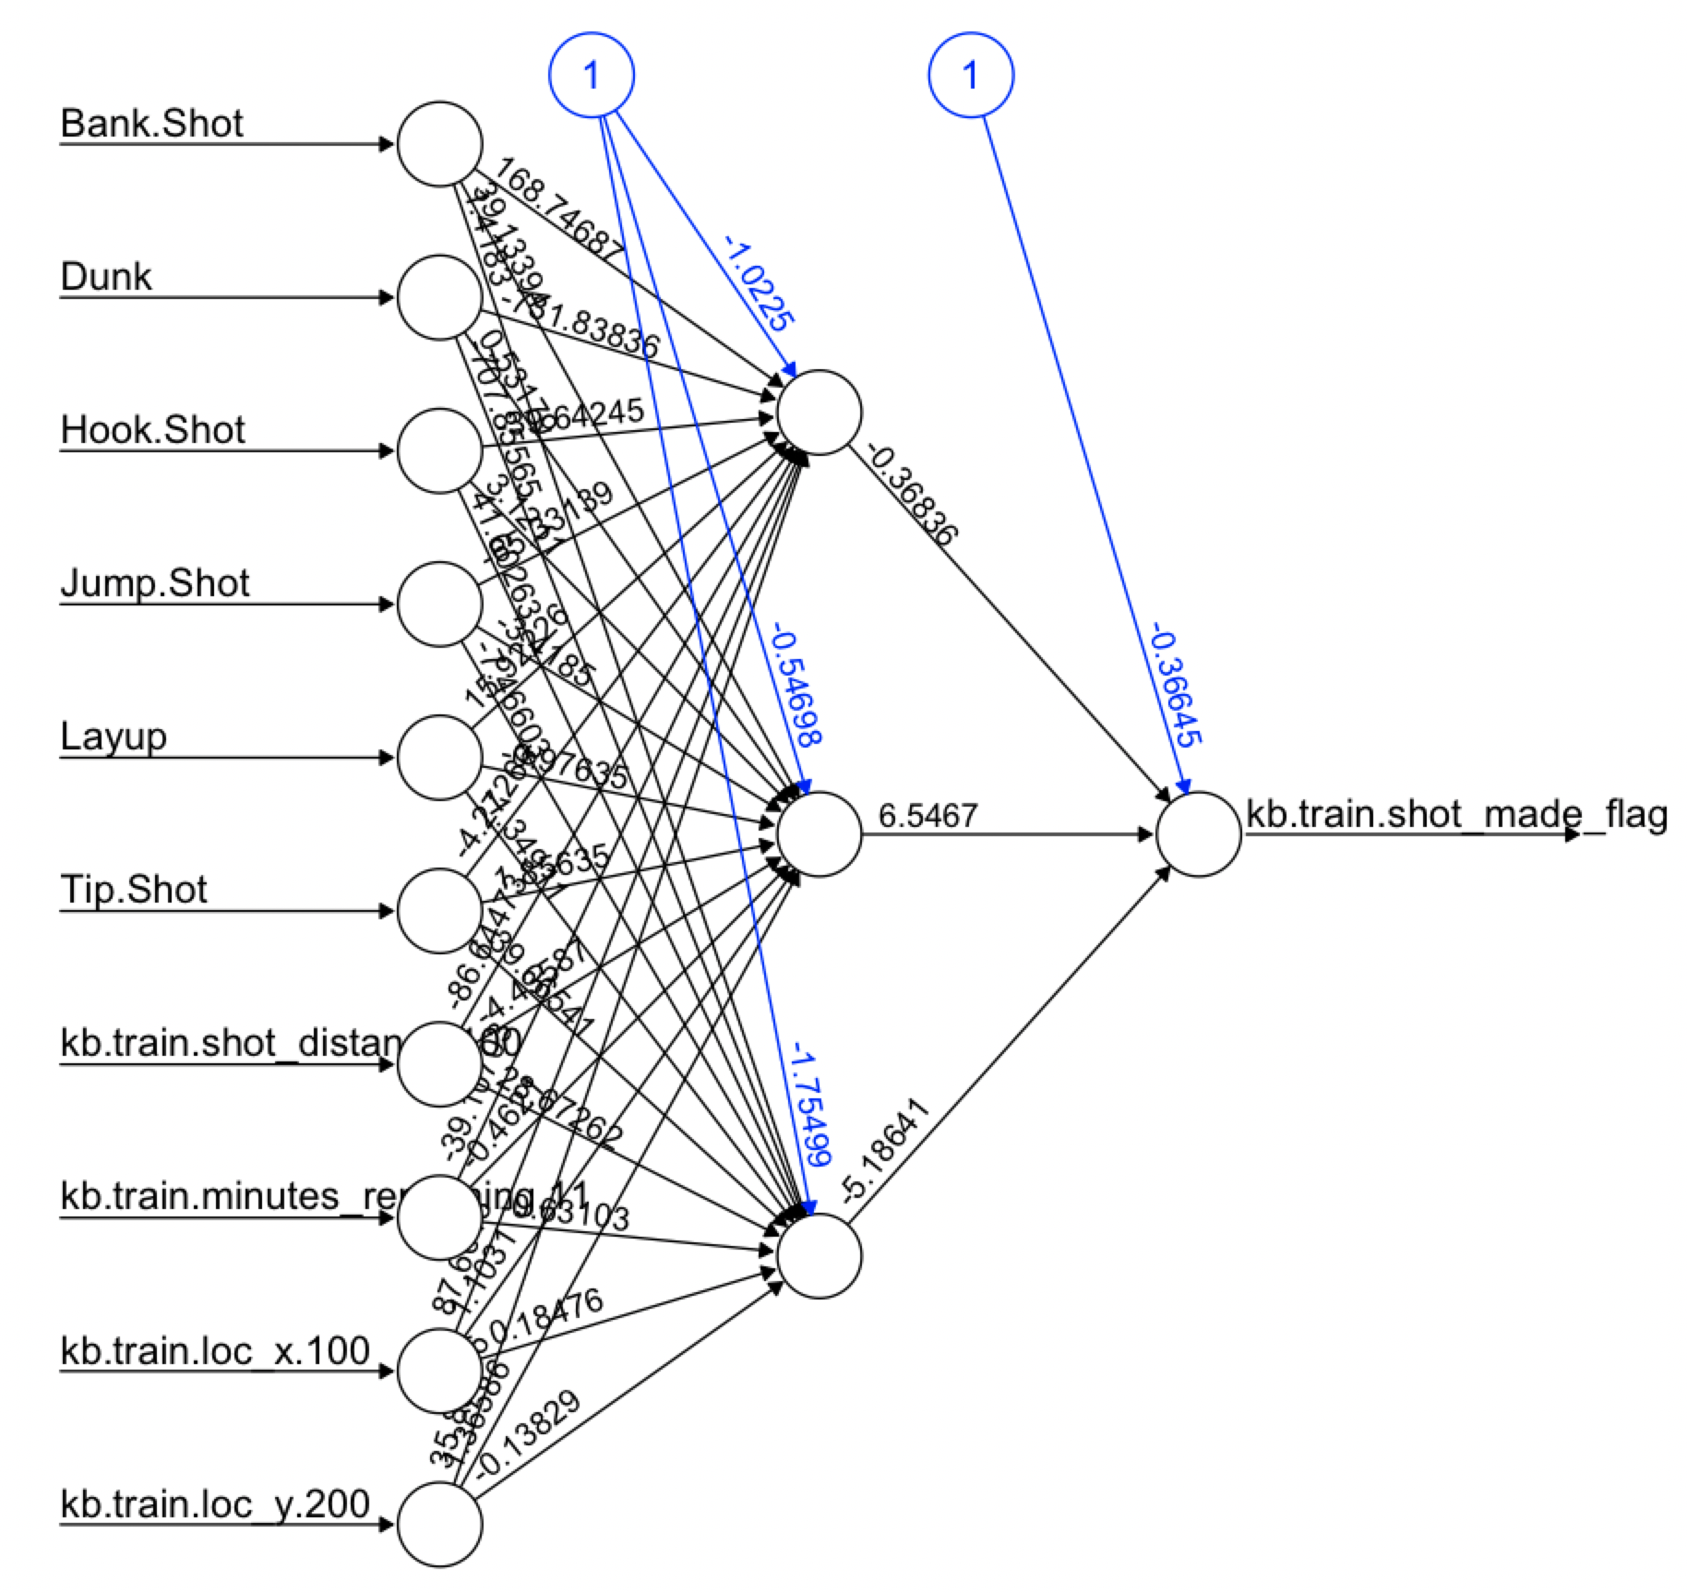
Neural Networks(NN) model - graph
Notes:
Input layer - hidden layer - output layer
NN model
Before we build the NN model, we should pick the column which is not numeric. We use the ‘class.ind’ function in the ‘nnet’ package to make it as dummy data. And also, we found the value in some columns are huge such as loc_x and loc_y, so we divided them by 100 and 200, just to make sure they didn't make a big difference.

Slide 27
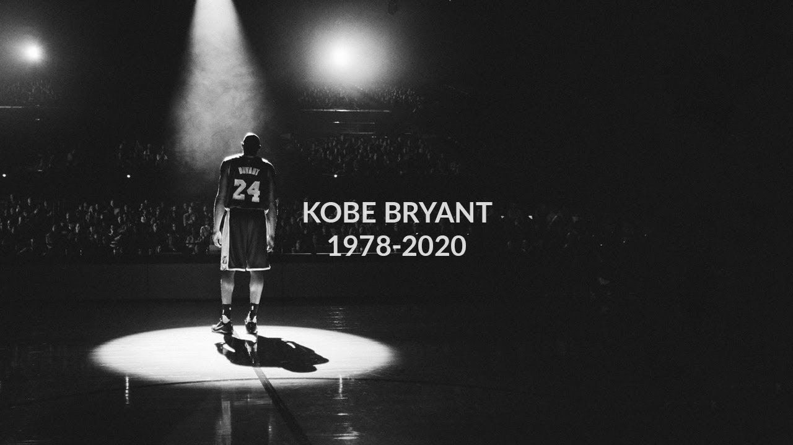
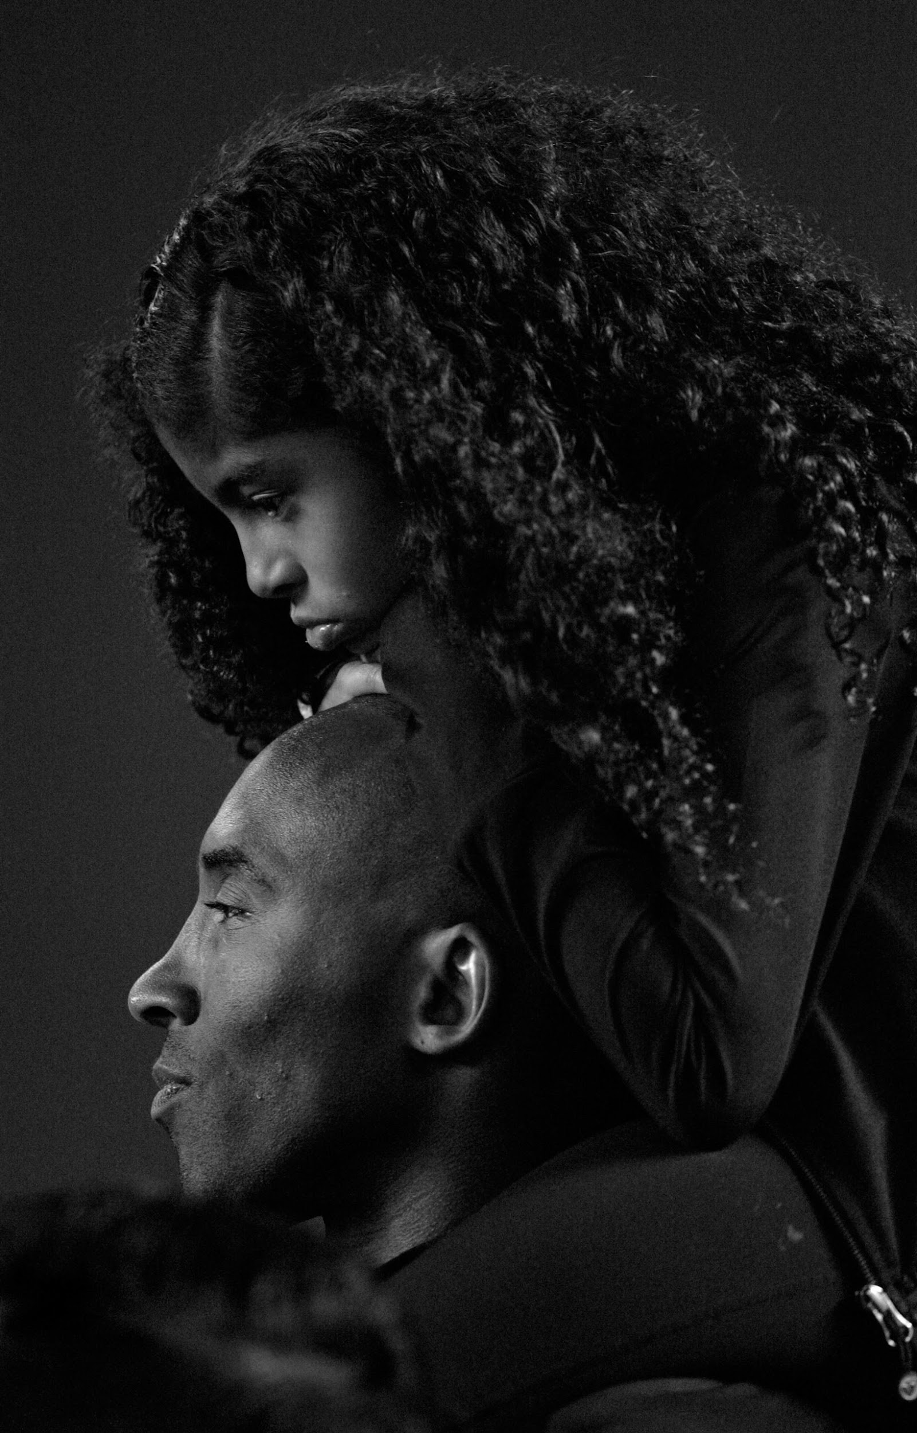
THANK YOU!

